Slide 1
Course Overview
COMP 40040: Agent-Oriented Software
Lecturer: Rem Collier
Email: rem.collier@ucd.ie

Slide 2
What is this Course About?
This course will explore the idea of Multi-Agent Systems.
What are they?
How do they work?
How do we build them?
Examples of their use…
Focus will be upon programming agents using Agent-Oriented Programming (AOP) languages:
Will explore 2 languages: Jason & ASTRA
Some exploration of methodologies:
SADAAM, GAIA
Overview of main agent concepts.

Slide 3
Course Assessment
End of Semester Exam: 50%
1 general compulsory question 50%
Choose 2 from 4 optional questions 25% each
Individual Software Development Project 50%
Will involve analysis, design and implementation of a system in an area of your choice.
You will be required to submit:
A completed program in an AOP language
A report providing an overview of what you did.
A completed set of analysis & design documents.
Experience in programming and methodologies will be built up informally during the week through example problems. This will not be assessed.

Slide 4
Lets Get It Started…

Slide 5
Distributed Artificial Intelligence
Traditionally, Artificial Intelligence has focused on how single human intelligence.
However, we do not act alone - a key feature of human society is our ability to communicate and cooperate…
This led to the emergence, in the 1970s, of a subfield of AI research, known as Distributed AI.
DAI is concerned with:
“the development of distributed solutions for complex problems regarded as requiring intelligence.”
Because of its aims and objectives, DAI research draws on a variety of fields:
Philosophy, Social Sciences, Economics / Game Theory, Linguistics, Computer Science/Engineering, …

Slide 6
Distributed Artificial Intelligence
By the end of the 1980s, DAI research split:
(Cooperative-) Distributed Problem Solving: Designing networks of semi-autonomous processing nodes that work together to solve a given type of problem.
Concerned with: problem decomposition, task allocation, result synthesis, system optimisation
Main technologies: Distributed Constraint Programming / Optimisation.
Multi-Agent Systems: Understanding how groups of computational entities, known as agents, can collaborate and cooperate in order to solve problems that are beyond their individual capabilities.
Concerned with: intelligent decision-making, coordination, negotiation, organisation, distributed problem solving, software engineering.
Main technologies: anything goes!

Slide 7
Multi-Agent Research Themes
Theories of Agency
Logical Models of Rational Action
Game Theoretical Approaches
Planning
Agent-Oriented Software Engineering
Tools, Languages and Methodologies
Environments
Standards
Multi-Agent Interaction
Cooperation and Coordination
Organisations & Institutions
Negotiation
Distributed Planning
Multi-Agent Learning & Problem Solving

Slide 8
Existing Applications of Agents
Military Simulations
US Military uses agents to train army officers and pilots (serious games), control bomb disposal robots.
Supply Chain Management
Proctor and Gamble have an agent-based supply chain that saves them around $300 million per year.
eProcurement
Deutshe Post use agents to match shipping needs with 6,000 German Freight Carriers and saves around $17M per annum.
Manufacturing
Daimler Chrysler used agents to automate a factory producing Cylinder heads and has seen a 10% increase in the plants productivity.

Slide 9
Existing Applications of Agents
Transportation
Southwest Airlines cut overnight transfer weight by 71% and saved $10M per annum in labour costs.
Games & Movies
Agents were used to model the soldiers in war scenes from Lord of the Rings
Space Systems
The ESA recently committed to using agent technologies to implement next generation space systems - multi-satellite constellations, mars rover teams, …

Slide 10
Agent Technology Companies
Whitestein Technologies / Living Systems Platform
WWW: https://www.whitestein.com/
Telecommunications
Logistics and Supply Chain Management
Insurance and Banking
Engineering and Manufacturing
Agent Oriented Software / JACK Agent Platform
WWW: http://aosgrp.com/
Aerospace and Air Traffic Control
Oil Trading and Operations
Defence
Virtual Actors and Serious Games

Slide 11
Agent Technology Companies
Magenta Technology / Maxoptra Platform
WWW: http://magenta-technology.com/
Real-time Scheduling / Intelligent Transportation
Intelligent Automation Inc. / Cybele (Pro)
WWW: http://i-a-i.com/cybelepro/
Distributed Robot Control
Scheduling and Planning
Behaviour-based Simulation
Massive Software (Massive Toolkit)
WWW: http://massivesoftware.com/
AI for Games
Virtual characters for TV/Movies
Engineering / Social Sciences Simulations

Slide 12
Core Concepts

Slide 13
Agents are Embodied AI
(Russell and Norvig, 1995) state that an agent is:
“anything that can be viewed as perceiving its environment through sensors and acting upon that environment through actuators”
Thus, they view an agent as:
any entity that is located in some environment, and which
interacts with that environment through a set of sensors and actuators.
They then extend this definition to identify an intelligent agent as any agent that embodies some AI technique.
This does not just apply to Expert Systems, but also to machine learning algorithms, planning algorithms, …

Slide 14
The Great Agent Debate
The term “agent” means different things to different people.
“An agent is a computer system that is situated in some environment, and that is capable of flexible, autonomous action in this environment in order to meet its design objectives”
(Wooldridge and Jennings, 1995)

Slide 15
The Great Agent Debate
In contrast, (Maes, 1995) views agents to be:
“computational systems that inhabit some complex dynamic environment, sense and act autonomously in this environment, and by doing so realise a set of goals or tasks for which they are designed.”
This posits a view of an agent as:
any autonomous software entity that is located in a complex dynamic environment, and which
exhibits goal-oriented behaviour, requiring that it act in pursuit of its own goals.

Slide 16
The Great Agent Debate
Alternatively, (Shoham, 1993) adopts the perspective that:
“An agent is an entity whose state is viewed as consisting of mental components such as beliefs, capabilities, choices, and commitments. These components are defined in a precise fashion, and stand in rough correspondence to their common sense counterparts”
This third definition adopts the view of agents as mental entities:
That is, entities that employ mental concepts such as beliefs, commitments, and goals in order to reason about both the environment and their activities…

Slide 17
One Definition to Rule them All…
In 1995, Michael Wooldridge and Nick Jennings proposed a two-tier definition of agency that has become a de facto standard for agent research.
The lower tier, or weak notion of agency, was intended to be sufficiently general to meet the needs of most agent researchers, and specified the following agent attributes:
Autonomy, social ability, reactivity, and pro-activity.
The upper tier, or stronger notions of agency, were intended to build on this weak core to provide more specific definitions, and specified attributes such as:
Benevolence, rationality, mobility, learning, intentionality, …

Slide 18
Weak Agency
Autonomy: Agents operate without the direct intervention of humans or others, and have some kind of control over their actions and internal state.
Social Ability: Agents interact with other agents and (possibly) humans via some kind of agent communication language.
Reactivity: Agents perceive their environment (which may be the physical world, a user via a graphical user interface, a collection of other agents, the Internet, or perhaps all of these combined), and respond in a timely fashion to changes that occur in it.
Pro-activity: Agents do not simply act in response to their environment, they are able to exhibit goal-directed behaviour by taking the initiative

Slide 19
Stronger Agency
Mobility: the ability of an agent to move around an electronic network.
Benevolence: Is the assumption that agents do not have conflicting goals, and that every agent will therefore always try to do what is asked of it.
Rationality: is (crudely) the assumption that an agent will act in order to achieve its goals and will not act in such a way as to prevent its goals being achieved - at least insofar as its beliefs permit.
Intentionality: an agent reasons about its activities through the application of mental notions such as beliefs, goals, obligations, commitments, intentions…

Slide 20
Intentional Systems
In arriving at the philosophy of intentional systems (Dennett, 1989) draws heavily on what he calls folk psychology which he defines as:
a perspective which invokes the family of “mentalistic” concepts, such as belief, desire, knowledge, fear, pain, expectation, intention..
Based on the view that human behaviour is often explained using these mentalistic concepts:
e.g. “Joe hit Bill because he wanted his bike”.

Slide 21
The Intentional Stance
This view of decision-making is inspired by the work of the philosopher Daniel Dennett (1989) who identifies 3 levels at which behaviour can be modelled:
Physical Stance: the domain of physics and chemistry; concerned with mass, energy, velocity, chemical composition, …
Predicting where a ball will land based on trajectory.
Design Stance: the domain of biology and engineering; concerned with purpose, function and design.
Predicting that a bird will fly when flapping its wings because this is what wings are for.
Intentional Stance: the domain of software and minds; concerned with belief, thinking, and intent.
Predicting that the bird will fly away because it knows the cat is coming and it is afraid of being eaten.

Slide 22
Intentional Stance and Agents
Using the Intentional Stance allows:
Abstraction from the underlying system complexity
Beliefs and knowledge, wants and desires, fears and joys, …
Simple to model rational decision-making processes:
X intends to move away from Y because X believes Y is too close and is afraid of Y.
The robot goes to the fridge because it believes that its master wants a beer.
Sits well with logic:
Believes(X, close(Y)) & Afraid(X, Y) => Intends(X, moveFrom(Y))
Believes(robot, wants(master, beer)) => Intends(robot, goto(fridge);get(beer);goto(master);give(beer))

Slide 23
Intentional Stance and Agents
The Argument:
Viewing the behaviour of software systems from an intentional stance allows us to provide a more abstract (simpler) definition of that behaviour. This, in turn, allows us to build more complex software...
Some argue that the use of the Intentional Stance is a pointless attempt to anthropomorphise programming.
“A fancy lookup table”
“An unnecessarily overcomplicated programming paradigm”
“What is the benefit of mental state programming?”

Slide 24
Intentional Stance and Agents
While a number of “mental models” have been proposed, a defacto standard, known as the Belief-Desire-Intention (BDI) architecture, has emerged:
Beliefs: the current state of the environment
Desires: the agent ideal future state of the environment
Intentions: subset of the desires that the agent commits to
Informally, BDI theories attempt to capture the transition between states.
Desires drive the agents activities and are satisfied when the agent believes that it has achieved them.
Agents are resource bounded, desires may be incompatible.
Intentions represent the trade off that the agent makes in terms of the subset of its desires that it commits to achieving.

Slide 25
The BDI Agent Control Loop
Sensor Input
Actuator Output
Start
Perceive
Deliberate
Act
BDI Agents typically implement the above algorithm:
Perceive: Gather sensor data and update beliefs
Deliberate: Update Desires & Intentions based on modified beliefs
Act: Perform 1 or more actions based on the current intentions of the agent.
This loop is executed continuously for the lifetime of the agent

Slide 26
Speech Act Theory
John Austin: some utterances are like physical actions…
“I now pronounce you man and wife”
What you “say” can be separated from its “intent” and “effect”:
Locutionary Act: the physical speaking of the word
Illocutionary Act: the action you are performing (the intent)
Perlocutionary Act: the effect of the act
John Searle: studied and classified Illocutionary Acts
Decompose illocutionary act to a performative (type) + content
Identified 5 categories of performative: representatives, directives, commissives, expressives and declaratives.
Notes:
Representatives or Assertives Speaker tells you information e.g. ”It is raining”.
Directives Speaker tries to make the hearer do something e.g. ”Please close the window”
Commisives Commits the speaker to future action e.g. ”I will close the window”
Expressives Speaker expresses a mental state e.g. ”Excuse me”, ”congratulations”
Declaratives Effect some changes e.g. ”I name this city Trondheim”

Slide 27
Speech Act Theory
Speech Act Type | Description and Example
Representatives / Assertives | Informing e.g. “it is raining”
Directives | Speaker tries to make the hearer do something e.g. “please close the window”
Commisives | Commits the speaker to a future action e.g. “I will close the window”
Expressives | Speaker expresses a mental state e.g. “excuse me”, “congratulations”
Declaratives | Effect some change e.g. “I name this room the ‘Rem Collier Room’”

Slide 28
Searle’s Theory
He then determined that speech acts can be decomposed in to 2 core components:
A performative verb
e.g. Request, inform
Propositional content
e.g. ”the window is closed”
Speech Act | Please close the door | The door is closed | Is the door closed?
Performative | request | inform | inquire
Content | the door is closed | the door is closed | the door is closed

Slide 29
Applying Speech Act Theory
In software, Speech Act Theory can be modelled as follows:
Locutionary Act: The act of sending a message
Illocutionary Act: The contents of the message
Perlocutionary Act: The effect of the message
Agent Communication Languages (ACLs):
A format for representing the contents of a message.
In theory, it consists of: performative + content
In practice, much more is required as agents lack the contextual information inherent in human communication.
ACLs define a set of valid performatives and an associated meaning (semantics) for them.
Semantics typically define how messages affect mental state

Slide 30
Applying Speech Act Theory
Two main ACLs to date:
1994 - Knowledge Query and Manipulation Language (KQML)
2000 - Foundation for Intelligent Physical Agents (FIPA) ACL
KQML developed for expert system interaction
Many flavours, generally compatible in theory but not in practice (both semantically and transport).
FIPA ACL is part of the wider FIPA standards
Everything was (over) specified.
Compatible at the syntactic and transport layers, but still semantic issues.
Both specify standard interaction patterns (protocols)
Broker, Recruiter, Subscriber, …

Slide 31
Agent-Oriented programming
“Programming in the Intentional Stance”

Slide 32
Agent-Oriented Programming
Introduced in 1993 by Yoav Shoham (Stanford).
OOP AOP
Basic Unit Object Agent
Parameters describing unconstrained beliefs, commitments,
state of basic unit capabilities
Process of Computation message passing and message passing and
response methods response methods
Types of Message unconstrained inform, request, offer
Constrains on Methods none honesty, consistency

Slide 33
Non-Exhaustive List of APLs
1993 Agent-0
1995 PLACA / AgentSpeak(L)
1998 JACK / 3APL
2002 GOAL / AF-APL
2004 Jason
2008 2APL
2010 AF-AgentSpeak
2011 simpAL
2012 ASTRA
2014 Blueprint

Slide 34
AgentSpeak(L)
Devised by Anund Rao in 1995:
A design for an AOP language – not an implementation
Attempts to bridge the gap between theory and practice
One-to-one correspondence between model theory, proof theory and abstract interpreter.
Based on a restricted first-order language with beliefs, goals, events and actions.
Implementations:
Jason (2004 – Bordini)
AF-AgentSpeak (2010 – Collier)
ASTRA (2012 – Collier)

Slide 35
AgentSpeak(L): The BDI Model
Dynamics:
Goal Generation: In response to changes to the environment and through sub-goals
Goal Selection: One goal per iteration with default ordering based on order of generation
Intention Achievement: Match goals to plans (with a context) that are executed in response to the goal
Key Idea:
Model dynamics in terms of events.
Mental State | Interpretation
Beliefs | as is the norm
Desires | represented as goals (assumed to be mutually consistent)
Intentions | plans that have been adopted to achieve goals

Slide 36
AgentSpeak(L): Basic Notions
Beliefs:
Constants (objects/concepts) are represented as lower case strings
rem, man, ball, …
Variables are represented as upper case strings
X, Value, …
Relationships/properties are represented as predicates:
isa(rem, man): represents the fact that rem is a man.
see(ball): represents the fact that the ball can be seen.
Checking state = querying beliefs
Like querying the fact base in Prolog.
The query belief is compared against the beliefs of the agent.
If a match exists, then the query is true, otherwise the query is false.

Slide 37
AgentSpeak(L): Basic Notions
Example:
Beliefs:
likes(rem, beer)
has(rem, beer)
is(rem, man)
likes(rem, coffee)
hates(rem, apples)
is(rem, silly)
Queries:
?likes(rem, beer) // does rem like beer?
?likes(X, coffee) // who likes coffee?
?is(rem, Y) // what is rem?

Slide 38
AgentSpeak(L): Basic Notions
Goals:
What the agent wants to achieve (predicates prefixed with !)
!find(ball), !goto(rem), …
Events:
Represent changes to the agents beliefs / goals.
an event can be
internal, when a subgoal needs to be achieved
external, when generated from belief updates as a result of perceiving the environment.
two types of triggering events:
related to the addition (‘+’) and deletion (‘-’) of beliefs or goals

Slide 39
AgentSpeak(L): Basic Notions
Plans:
the basic abilities of an agent (i.e. how it can affect its environment).
te : ct <- h
Where:
te - triggering event (denoting the purpose for that plan)
ct - a conjunction of belief literals representing a context.
h - a sequence of basic actions or (sub)goals that the agent has to achieve (or test) when the plan, if applicable, is chosen for execution.

Slide 40
AgentSpeak(L): Basic Notions
Example Plans:
“If we believe a concert by artist A will take place at venue V and we like A, adopt an achievement goal to book tickets for the concert.”
+concert(A,V) : likes(A) <-
!book_tickets(A,V).
“If we have a goal to book tickets and the phone is not busy, call the venue and adopt an achievement goal to choose seats.”
+!book_tickets(A, V) : ~busy(phone) <-
call(V);
!choose seats(A,V).

Slide 41
AgentSpeak(L): Basic Notions
Intentions: plans the agent has chosen for execution.
Represented as a stack.
Intentions are executed one step at a time:
query or change the beliefs
perform an action on the external world
submit new goals.
The operations performed by a step may generate new events, which, in turn, may start new intentions.
An intention succeeds when all its steps have been completed; it fails when certain conditions are not met or actions being performed report errors.

Slide 42
AgentSpeak(L): Interpreter
select an event, e, from the agents event queue
match the event to a plan rule, p whose triggering event matches e, and whose context is satisfied.
if e is a belief adoption / retraction event then create a new intention to process the behaviour specified in p else update the intention that generated e to also process the behaviour specified in e.
select one intention, i and execute its next step.
return to 1

Slide 43
AgentSpeak(L): Interpreter
Algorithm Interpreter()
// Process the next event
e <- selectEvent()
if (e != ᴓ) then
o <- selectOption(e)
if (o != ᴓ) then
applyOption(o)
endif
endif
// Perform an action
i<- selectIntention()
if (i != ᴓ) then
executeIntention(i)
endif

Slide 44
AgentSpeak(L): Summary
AgentSpeak(L) is a theoretical (but computationally tractable) AOP language.
The central concept in AgentSpeak(L) is the notion of a partial plan that can be applied to resolve some triggering condition in some context.
AgentSpeak(L) says nothing about communication, although communication is easy to add.
But, AgentSpeak(L) has been used as a basis to explore a range of more advanced concepts (cooperation, organization, …)

Slide 45
Jason
http://jason.sourceforge.net/

Slide 46
Jason: Internal Actions
Library of pre-written actions that can be used directly by the agent without needing to setup an environment:
.abolish(<belief>) drop all matching beliefs
.broadcast(<perf>, <content>)send content to all agents
.fail() action that fails
.print() print to the console
.println() print a line to the console
Full list: http://jason.sourceforge.net/api/jason/stdlib/package-summary.html

Slide 47
Jason: Annotation Model
Mechanism for adding tags to beliefs (and goals) – represent, for example, the source of a belief or a certainty factor.
blue(box1)[source(ag1)]
red(box1)[source(percept)]
colourblind(ag1)[source(self), cf(0.7)]
liar(ag1)[source(self), cf(0.2)]
Querying of beliefs can include annotations:
?blue(X) // is there a blue box?
?blue(X)[source(Y)] // is there a blue box and // who told me?
?red(X)[source(percept)] // did I perceive a red box?
?colourblind(X)[source(ag1)] // did ag1 tell me that X // is colour blind?

Slide 48
Jason: Agent Communcation
KQML-based communication:
Performatives (incomplete): tell, untell (knowledge transfer) achieve, unachieve (asking for help)
Sending Messages: .send(<receiver>, <perf>, <content>)
Receiving Messages: +!kqml_received(<sender>,<perf>,<content>,<msg_id>)
Default semantics of message passing:
.send(X, tell, Y) X adds belief Y[source(<sender>)]
.send(X, achieve, Y) X adds goal !Y[source(<sender>)]
.send(X, untell, Y) X drops belief Y[source(<sender>)]

Slide 49
Programming with Jason
Jason can be programmed through jEdit plugin or through and Eclipse plugin (preferred).
Installation Tutorial: http://jason.sourceforge.net/mini-tutorial/eclipse-plugin/
Jason programs consist of two file types:
AgentSpeak Language files (.asl) – the agent code
Deployment Files (.mas2j) – platform configuration

Slide 50
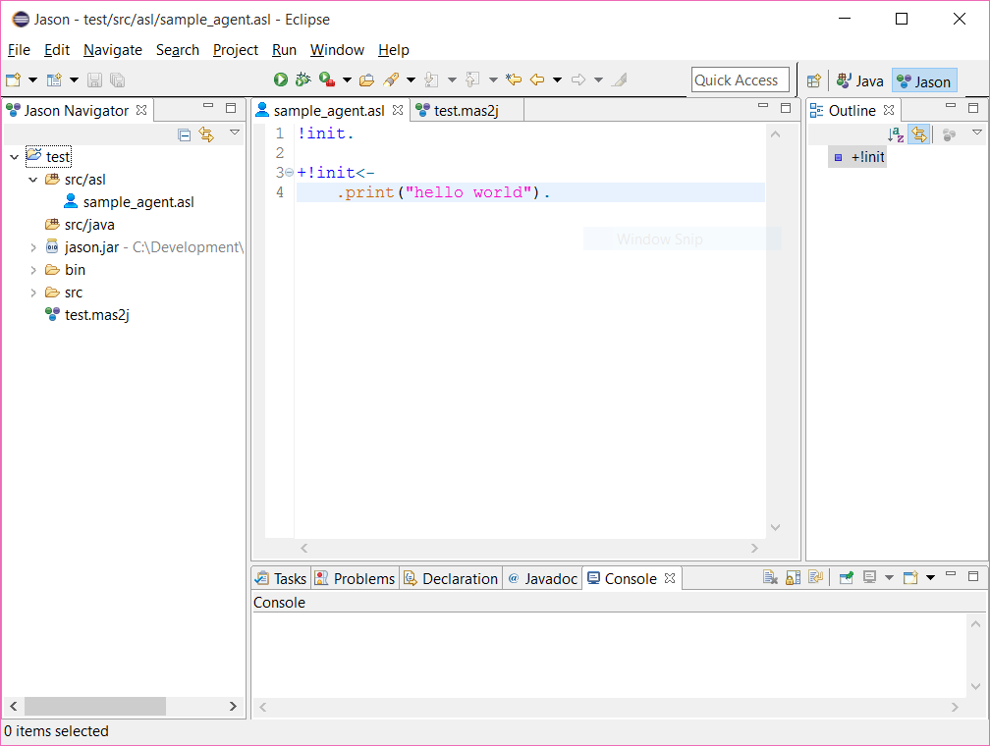
Programming with Jason

Slide 51
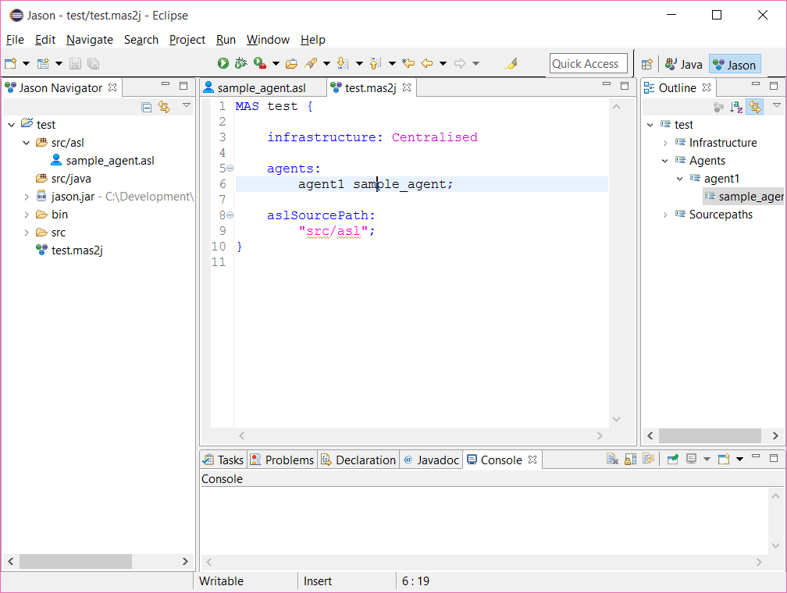
Programmng with Jason

Slide 52
Jason: Hello World
Hello World:
!hello.
+!hello <- .print(“hello world”).
Hello World (3 Times):
!hello(3).
+!hello(X) : X > 0 <-
.print(“hello world”);
!hello(X-1).

Slide 53
Jason: Subgoals
!init.
+!init <- !printHello().
+!printHello <- .println(“hello world”).
!init.
+!init <- !printHello(3).
+!printHello(X) : X > 0 <-
.println(“hello world”);
!printHello(X-1).

Slide 54
Jason: Belief Queries
// initial beliefs
is(rem, happy).
// initial goal
!init.
// main rule
+!init <-
.println(“starting”);
?is(rem, happy);
.println(“first hurdle passed”);
?is(rem, sad);
.println(“ending”).

Slide 55
Jason: Belief Update
light(on).
+light(on) <-
.println(“the light is on, turn it off”);
-light(on);
+light(off).
+light(off) <-
.println(“the light is off, turn it on”);
-+light(on).

Slide 56
Jason: Fibonacci
Fibonacci Number Generator:
+!fib(X, N) : X < N & fib(X-1, Y) & fib(X-2, Z) <-
+fib(X, Y+Z);
!fib(X+1, N).
+!fib(X, N) : X == N & fib(X-1, Y) & fib(X-2, Z) <-
+fib(X, Y+Z).
The behaviour is triggered by the following initial mental state:
fib(1,1).
fib(2,1).
!fib(3,50). // generates the first 50 numbers...

Slide 57
Jason: Ping-Pong
Ping Agent:
!start.
+!start <-
.println("starting...");
.wait(500);
.send(bob, achieve, ping).
+!ping <-
.println("ping");
.wait(500);
.send(fred, achieve, pong).
Pong Agent:
+!pong <-
.println("pong");
.wait(500);
.send(bob, achieve, ping).

Slide 58
Jason: Ping-Pong
MAS test {
infrastructure: Centralised
agents:
fred pong;
bob ping;
aslSourcePath:
"src/asl";
}

